Slide 1
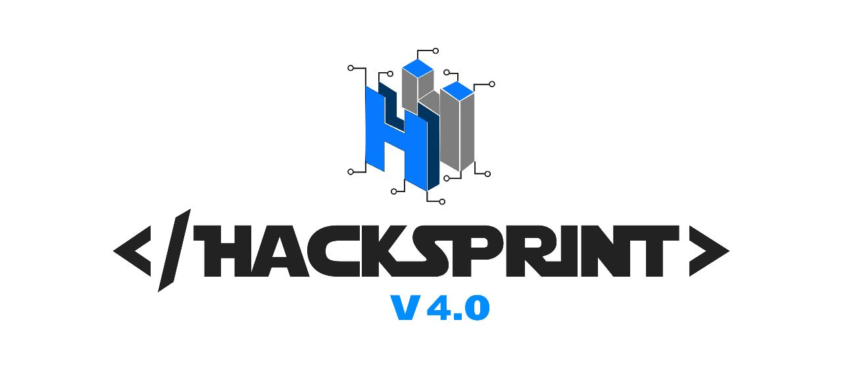


Runtime Terror

Slide 2

Runtime Terror
Sumit Karpe
Soham Mirikar
Bharat Addagatla

Slide 3

Machine Learning
Develop a Machine Learning model for the Preventive Maintenance of Electric Vehicles or any other machine

Slide 4

Idea / Approach
To predict a maintenance break
To avoid bringing an entire production line to a halt
To predict system breakdown

Slide 5
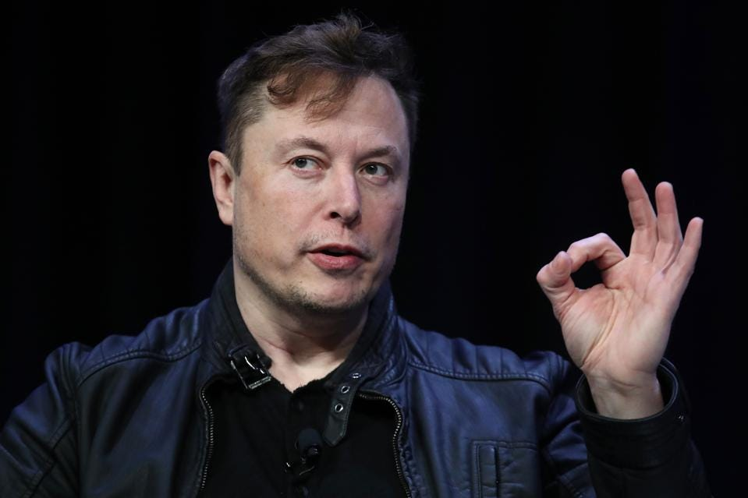
Implementation
Get a good quality dataset
Data cleaning
Feature Engineering
Appropriate Algorithm selection
Applying PNC for various algorithms and Dataset iterations

Slide 6

Technology
Scikit Learn
Excel
Random Forest Regressor()

Slide 7


Slide 8

Scope of Monetization
License the model
Sell it as a software
Sell it as an add on hardware accessory

Slide 9
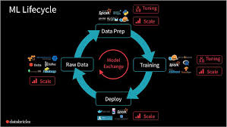
Day 1
Data Cleaning
Feature Engineering
Training the machine learning model
Peak accuracy achieved 94.8%

Slide 10
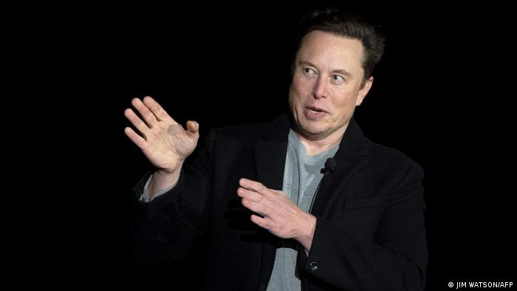
Day 2
Presentation
GUI
Updated GitHub Repository

Slide 11
